Slide 1

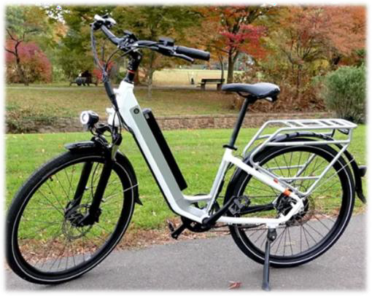
Know the Rules About Operating Electric Assisted Bicycles and Motorcycles

Slide 2
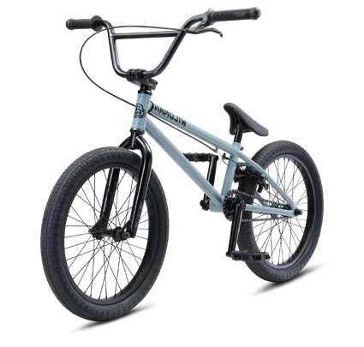
With so many different options on the market, it’s especially important to understand the key differences between bicycles and motorcycles. The Camas Police Department wants all riders to be safe and avoid costly infractions.
Knowing what type of electric bicycle or motorcycle you own and what rules apply to that unique transportation is important. This brochure provides information about the types of transportation devices and relevant state and local rules.
Definitions
The Revised Code of Washington (RCW) clearly defines the differences between a bicycle, an electric-assisted bicycle, and a motorcycle (Title 46 Chapter 04).
RCW 46.04.071 states “Bicycle" means every device propelled solely by human power, or an electric-assisted bicycle as defined in RCW 46.04.169, upon which a person or persons may ride, having two tandem wheels either of which is sixteen inches or more in diameter, or three wheels, any one of which is twenty inches or more in diameter.

Slide 3
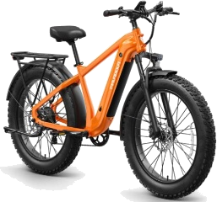
RCW 46.04.169 states “Electric-assisted bicycle" means a bicycle with two or three wheels, a saddle, fully operative pedals for human propulsion, and an electric motor. The electric-assisted bicycle's electric motor must have a power output of no more than seven hundred fifty watts. Electric-assisted bicycle must meet the requirements of one of the following three classifications:
"Class 1 electric-assisted bicycle" means an electric-assisted bicycle in which the motor provides assistance only when the rider is pedaling and ceases to provide assistance when the bicycle reaches the speed of twenty miles per hour.
"Class 2 electric-assisted bicycle" means an electric-assisted bicycle in which the motor may be used exclusively to propel the bicycle and is not capable of providing assistance when the bicycle reaches the speed of twenty miles per hour.
"Class 3 electric-assisted bicycle" means an electric-assisted bicycle in which the motor provides assistance only when the rider is pedaling and ceases to provide assistance when the bicycle reaches the speed of twenty-eight miles per hour and is equipped with a speedometer.

Slide 4
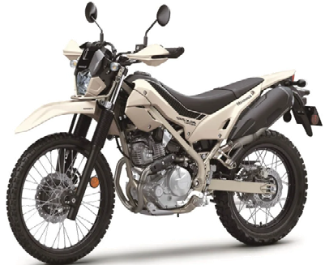
RCW 46.04.330 states “Motorcycle" means a motor vehicle designed to travel on not more than three wheels, not including any stabilizing conversion kits, on which the driver:
Rides on a seat or saddle and the motor vehicle is designed to be steered with a handlebar; or
Rides on a seat in a partially or completely enclosed seating area that is equipped with safety belts and the motor vehicle is designed to be steered with a steering wheel.
"Motorcycle" excludes a farm tractor, a power wheelchair, an electric personal assistive mobility device, a motorized foot scooter, an electric-assisted bicycle, and a moped.
In short, bicycles have pedals. Electric- assist bicycles have a maximum speed of 20 mph (when pedals are not being used), or with the use of pedals the maximum speed is 28 mph.
A motorcycle is only powered by a motor, regardless of whether the motor is battery powered or powered by fuel. A motorcycle does not have pedals. Foot pegs are not pedals.

Slide 5
Helmets are Required for All Riders!
Camas Municipal Code (CMC 10.24) requires a helmet be worn by all bicyclists who ride in or upon any public area within the city. Helmets are required for motorcycle operators and riders (RCW 46.61.755).
Riding on a roadway - When riding on a roadway, a bicyclist has the same rights and responsibilities as vehicle drivers (RCW 46.61.755). A bicycle is a legal vehicle, just like a car. Bicyclists who violate traffic laws may be ticketed (RCW 46.61.750).
Riding on a sidewalk - When riding on a sidewalk or a crosswalk, a bicyclist has the same rights and responsibilities as a pedestrian (RCW 46.61.755). Class 3 e-bikes are forbidden on sidewalks unless there is no alternative to traveling over a sidewalk as part of a bicycle or pedestrian path or if authorized as acceptable by local ordinance (RCW 46.61.710) Camas City Code prohibits riding bicycles on sidewalks in the Downtown District.
Shared-use paths and trails – Class 1 and 2 e-bikes are allowed on shared- use paths. Class 3 e-bikes are not allowed on shared- use paths. All classes of e-bikes are not allowed on trails designated as non- motorized or that have a natural surface (RCW 46.61.710).

Slide 6
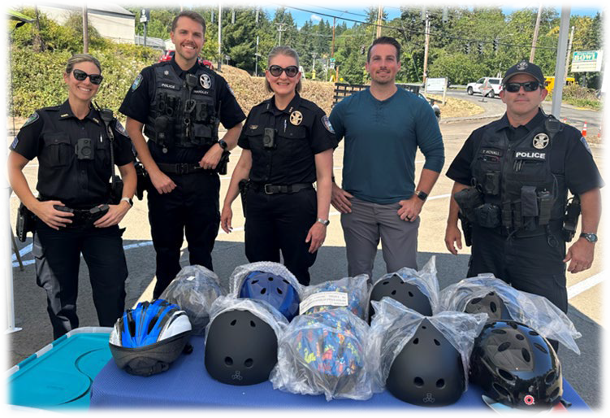
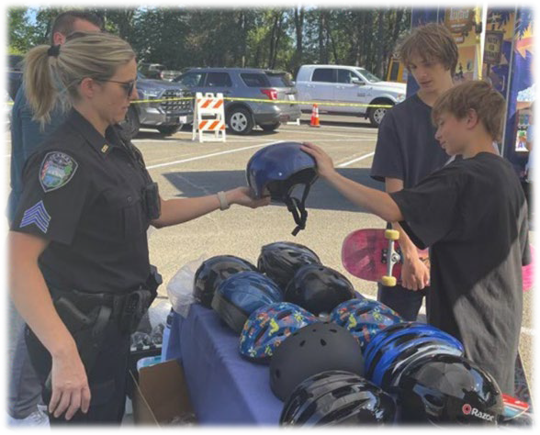
Motorcycles Require a State Permit
In Washington State, motorcycle riders need a permit (starting at age 16) or an endorsement (for those 18 and older). The RCW Title 46 outlines the speci�ic requirements for equipment and licensing. Riders under 18 must have parental consent and complete a motorcycle safety course, according to the Washington State Department of Licensing.

